Slide 1
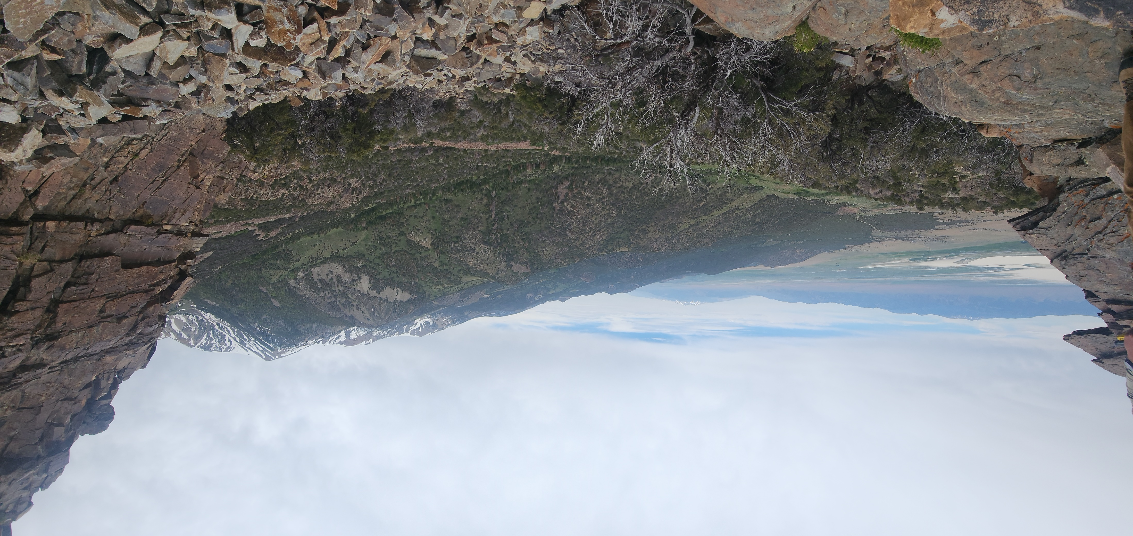
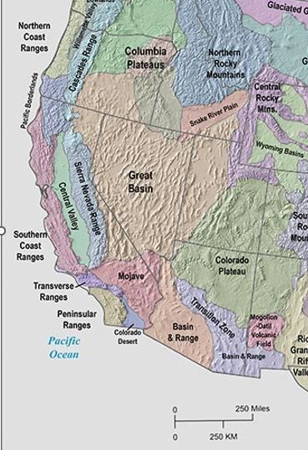
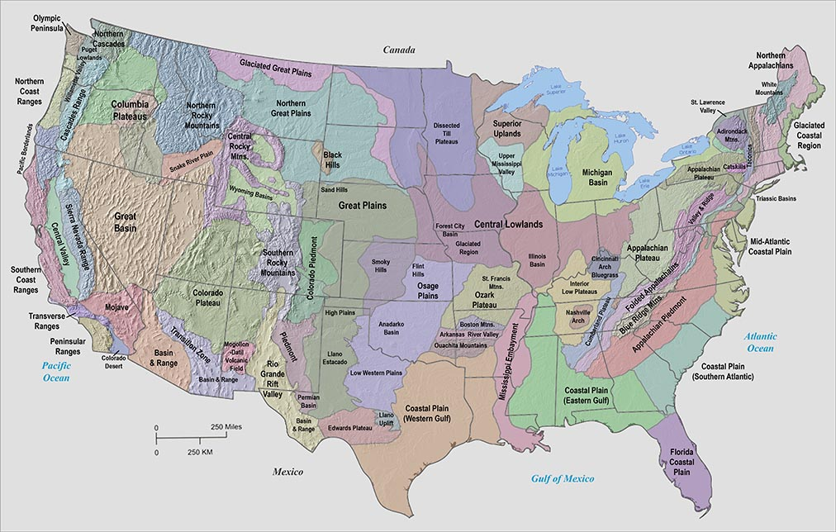
Tertiary Igneous Chronology of the Great Basin of Western United States-Implications for Tectonic Models
Mckee 1971

Slide 2
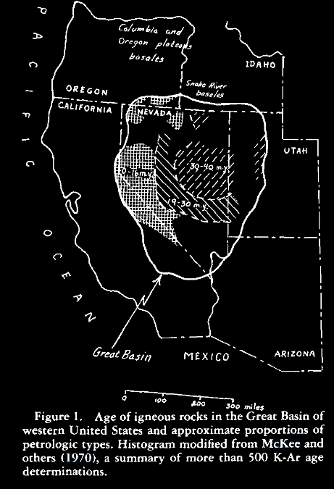
Introduction
Great Basin geologic province
Provides evidence for the evolution of the Cordillera subduction into the Paleogene.
Suites of igneous rocks provide proxies for understanding progressive subduction of the Farallon plate
Igneous rocks provide K-Ar dates to enforce proposed models of Farallon plate subduction
Two significant dates
35-40 Ma
16 Ma
17-19 Ma (less important to study)

Slide 3
Ages of Volcanic Rocks
Phase I:
Igneous activity started 35-40 Mya
Andesites/Dacite and Rhyolites (low ${SiO}_{2}$)
Quartz Monzonites (Oligocene)
Phase II:
16 Mya
Basalts and Ol. Basalts
Contains a Bimodal assemblage of:
alkali-olivine and thoeiitic basalts
High-Si subalkaline and peralkaline rhyolites
Younging to SW

Slide 4
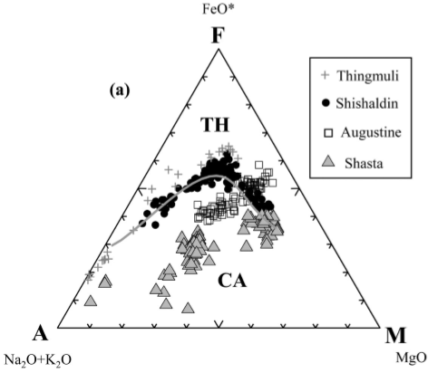
Younger volcanic Rocks
Sub-alkaline:
Tholeiitic vs Calc-alkaline
Basalts: Alkali-olivine and tholeiitic
Generally, results from rifting and MOR respectively
Rhyolites: Subalkaline and Peralkaline (low SI High Na-k)
From subduction and rifting/plumes respectively
Bimodal volcanism may support certain models of petrogenesis in the Great Basin.

Slide 5
What Models must include
Initial volcanic activity starting in central GB
Extruded on erosional surface of low-moderate relief
No tectonics association
Oligo-Miocene→ stable (erosion dominates)
Younger volcanics on the margins of GB
16 Mya resurgence of volcanism
Coeval w/ high-angle normal faults
Tectonism resulted in present day overall extension of GB.

Slide 6
Proposed Model
Considers new and exciting sea-floor spreading and continental drift!
EARLY CENOZOIC➔Sea-floor speading along the east pacific rise caused the farrallon plate to subduct under north America
60 Ma→ Subducting plate reached partial melting temps
Andesites and and rhyolites of central GB 30-40 Ma
Volcanism continued until ~19 Mya (or as long as the plate subducted)
18 Mya plate completely subducts, volcanism stopped until 16 Mya
Rise positioned under great basin causing extension and basaltic eruptions.

Slide 7
Flat slab subduction & rollback
Agrees well with Atwaters modeling predictions of volcanism, subduction and timing however…
Oldest volcanics 400-600 Km inland and migration of volcanism towards the trench remains an open question…or does it? (old paper)…Maybe a plume? (Morgan 1972)

Slide 8
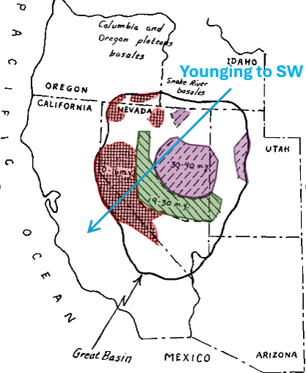
Conclusions
Two significant dates must be considered for any model for Great Basin volcanism
35-40 Mya and 16 Mya
17-19 Ma no volcanics less important but still matters
Discrepancies between models and K-Ar dates may be due to→
Variable spreading rates
Incorrect geometry for tectonic model
Tertiary volcanic rock may not be related to plate tectonics at all.

